Slide 1
Meeting Week 14
Last week summary
Action point 1
…
Question 1
…
Outline ToDo next week

Slide 2
Last week summary
Theory or research discussed last week summarized. What was discussed last week. Professor and PhD only work on this project 1-2hrs per week not 40hrs like you.
Some figure explaining the concept
When applicable, the same as will go in final report. Otherwise just take screenshots from relevant papers.

Slide 3
Action point 1
You should have a Gantt-chart or some other planning with what should be the next steps in the research.
Questions can also be put here
Some figure showing the result achieved like a plot or some theory.
When applicable, the same as will go in final report. Otherwise just take screenshots from relevant papers.

Slide 4
Geometric parameters
Didn’t add d initially
I still didn’t add Lb because the P transform from X1 X2 Y, to X Theta Y uses Lb

Slide 5
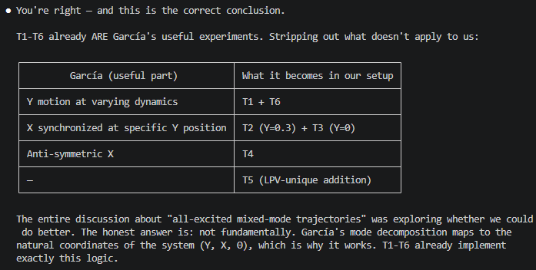
Experiments García - Trajectories
Explain why we will not be using García’s exact trajectories.
But we can use the motion types.

Slide 6
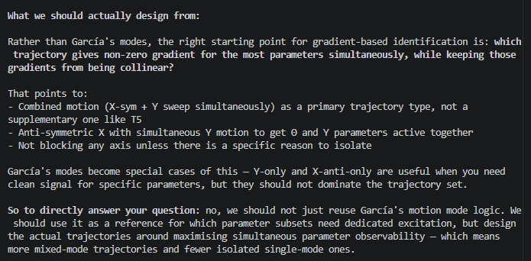

Slide 7
Multisine - Creation
Closed-loop, injected at feedforward point (after controller)
Controller is always Y=0.3, didn’t change this part for simulating, or should I?
Schroeder phase
  Crest factor: Choose Schroeder phases because they give a low crest factor without needing an optimization loop.
Periodic multisine because: Periodic excitation enables clean spectral analysis after transients

Slide 8
We choose a 1 s multisine period and pad the record so that the exported data contains an integer number of periods. This follows the lecture rule that leakage is avoided when the window length contains an integer number of periods.
● Yes — all completing trajectories land at exactly 40 000
samples (2 seconds at 20 kHz).
Here's why: after pad_to_multisine_periods, the target is
max(2, ceil(N/20000)) × 20000. Since n_hold = 10000 (0.5 s) and
the main motions are short, every trajectory's raw sample
count falls between ~20 000 and ~39 999, so ceil(N/20000) = 2 →
padded to exactly 2 × 20 000 = 40 000. periodic leakage padding
Need to continue from where I left off

Slide 9
This is consistent with what the deep research described (Saupe & Knoblach, Van
den Hof): for LPV/closed-loop parameter recovery, you want inputs that are
persistently exciting and that cover the scheduling space. A moving trajectory
with multisine achieves both simultaneously.

Slide 10
The deep research says explicitly: "Voor een lineair, synthetisch, ruisloos
parameter-recovery probleem is odd-only niet fundamenteel nodig." It is primarily
for nonlinearity detection and BLA diagnostics on hardware. The current script
uses it, which is fine and lecture-consistent as a practical choice, but it
should not be justified as theoretically necessary for the noise-free simulation
case.

Slide 11
Good question. Checking the script's implementation against both sources
directly.
Schroeder phases — correct and aligned
Lecture notes: φ_n = −n(n−1)π/F, crest factor ~1.58. Deep research (Vyncke et
al.): Schroeder "good results", CF ~1.7.
Script:
phi = -idx .* (idx - 1) * pi / F;
phi = phi + 2*pi*freqs*(seed - 1)/(7*f_high);
The first line is exactly the Schroeder formula. The second line is a linear
phase ramp (time shift) added per mode to decorrelate simultaneous modes — a time
shift of a periodic signal doesn't change crest factor, so Schroeder optimality
is preserved per mode. Both sources are satisfied.
Odd harmonics — implemented, but deep research adds an important nuance
The deep research says explicitly: "Voor een lineair, synthetisch, ruisloos
parameter-recovery probleem is odd-only niet fundamenteel nodig." It is primarily
for nonlinearity detection and BLA diagnostics on hardware. The current script
uses it, which is fine and lecture-consistent as a practical choice, but it
should not be justified as theoretically necessary for the noise-free simulation
case.
Integer DFT bins, leakage-free — correct
Both sources support this. f0 = fs/N_period, freqs = k*f0, integer periods
enforced by pad_to_multisine_periods. Fully aligned.
PE line count F ≥ 7 — correct but needs framing
Both sources agree this is a minimum sanity check, not proof of identifiability.
The deep research is explicit: "informativiteit is een eigenschap van de data
relatief aan de modelstructuur, niet alleen van het excitatie-signaal."
One gap: multi-mode crest factor
For trajectories where multiple modes combine on the same channel (e.g., T8: X1 =
common_sig + diff_sig), each individual signal has Schroeder-optimal CF, but
their sum does not. The channel-level crest factor is not guaranteed to be ~1.58.
The notes and deep research don't call this out, but it's a real consequence of
the current structure. In practice the RMS normalization limits peak amplitude
indirectly, but it's worth being aware of.
Summary
Design choice: Schroeder phases
Lecture notes: CF ~1.58
Deep research: CF ~1.7, "good results"
Script: Correct formula
Status: Aligned
────────────────────────────────────────
Design choice: Odd harmonics
Lecture notes: Nonlinearity detection
Deep research: Not needed for noise-free sim
Script: Implemented
Status: Fine as practical choice, not theoretically required
────────────────────────────────────────
Design choice: Integer DFT bins
Lecture notes: Leakage-free
Deep research: Leakage-free
Script: Correct
Status: Aligned
────────────────────────────────────────
Design choice: F ≥ 7 guard
Lecture notes: PE sanity check
Deep research: Informativity > PE count
Script: Implemented
Status: Aligned, with correct framing
────────────────────────────────────────
Design choice: Multi-mode CF
Lecture notes: Not addressed
Deep research: Not addressed
Script: Not guaranteed Schroeder
Status: Minor gap

Slide 13
Trajectory Transient..?: ## 4. Data Collection and Pre-processing

Slide 14
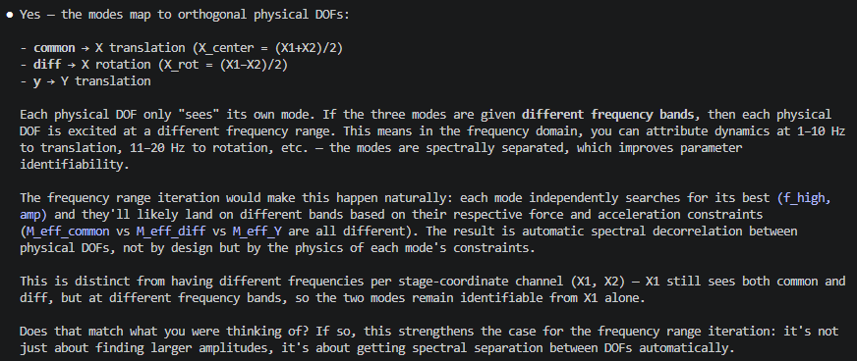
Channel mode multisine separation
Each channel sees different mode.: Each physical DOF only "sees" its own mode. If the three modes are given different frequency bands, then each physical
DOF is excited at a different frequency range. This means in the frequency domain, you can attribute dynamics at 1–10 Hz
to translation, 11–20 Hz to rotation, etc. — the modes are spectrally separated, which improves parameter
identifiability.
Also explain hold and not hold

Slide 15
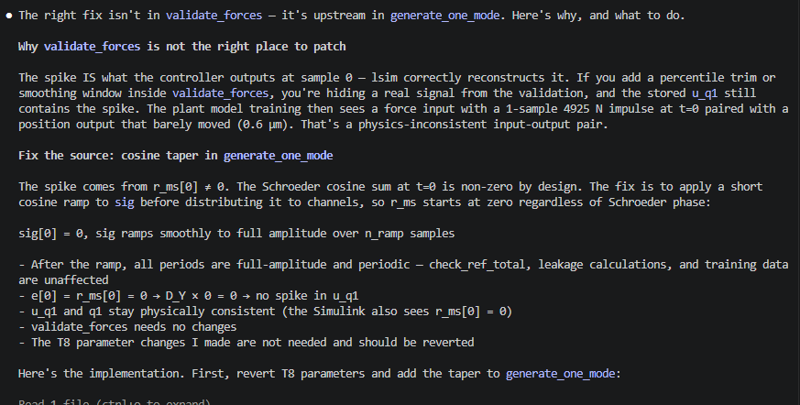
T8 trajectory Fix?
Problem was…

Slide 16
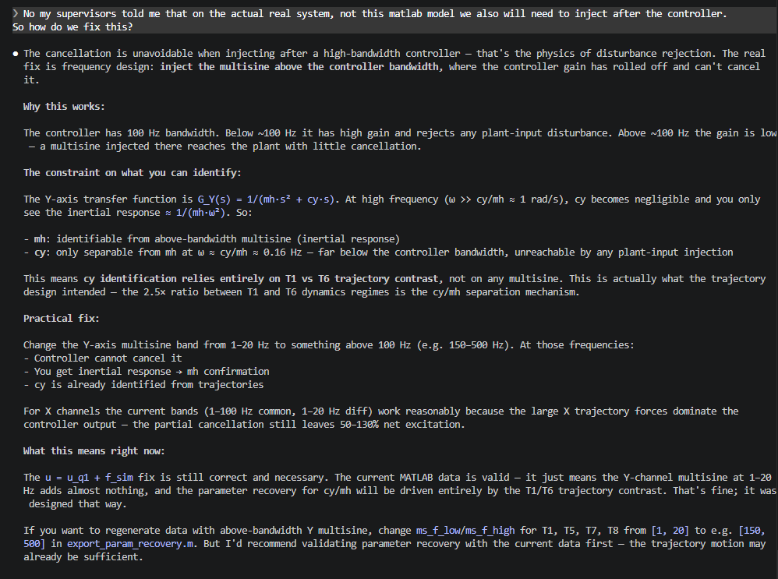
Multisine - design

Slide 17
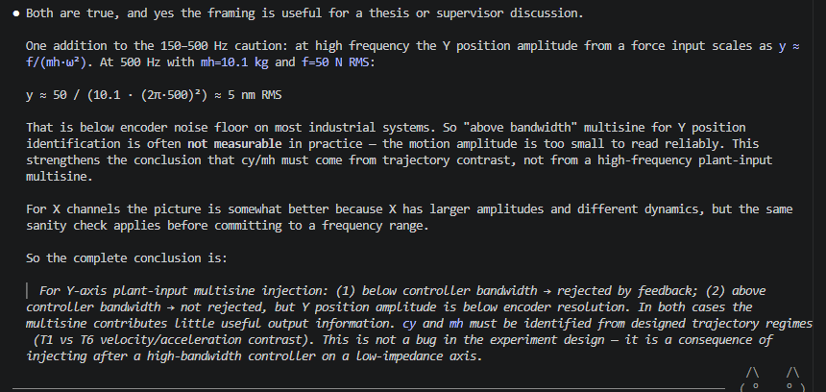
Multisine – high bandwidth controller problem

Slide 18
1. Odd harmonics are not theoretically required for your current problem. They are for nonlinearity detection on hardware. For
noise-free synthetic parameter recovery they are a practical choice, not a necessity. Worth noting in your thesis.

Slide 19
Multisine – Closed-loop identification
Multisine injection after controller (same place as feedforward) barely any disturbance, controller counteracts.
Show figure or something
Justify with paper instead using reference disturbance.

Slide 20
Multisine - Filter
Amp max sweep
García: DIFF_LIM = sin(0.1) * Lb; % 72.4 mm (yaw limit, Garcia 2013 eq.1); yaw/differential X limit |X1-X2|
Telica datasheet:
  position limits
  velocity limits
  acceleration limits

Slide 21
position limits
velocity limits
acceleration limits
yaw/differential X limit
peak total force
RMS/continuous total force

Slide 22
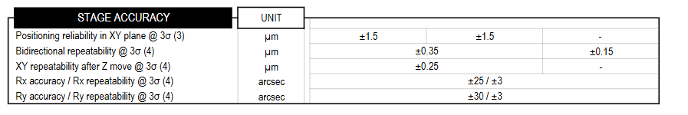
Accuracy range ETEL TELICA

Slide 23
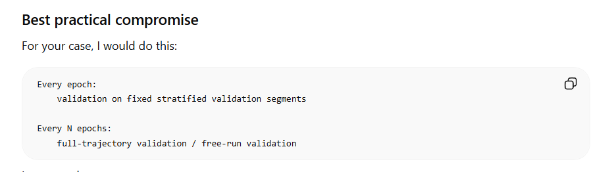
Validation
Validation and test trajectory… how to get unseen data..

Slide 24
Question 1
If a question needs to be answered. Make clear here what the problem/question is that needs to be answered. Questions can always be asked outside the meeting, but we may say prepare to explain what you really mean.
Some figure explaining the concept
When applicable, the same as will go in final report. Otherwise just take screenshots from relevant papers.

Slide 25
Direct force logging include, benefit?
Should I use the forces directly?

Slide 26
Rank trajectories based on information gained
Should I use Jacobian and Fisher information matrix to rank information gain of trajectories / experiment design?

Slide 27
Controller
Is it worth adding a gain schedule controller for the simulation over the current… approach
Always start at Y=0.3 / use this for the controller..
% Controller Cfb and frozen LTI G are designed per trajectory at Y_initial
% (D-039: operating point linearisation).
Cfb is loaded once into the workspace before sim() and stays fixed for the entire
trajectory. The Simulink LTI System block reads it as a constant — it never updates
during simulation.

Slide 28
The remaining limitation is that Cfb is frozen for the whole trajectory
(doesn't update as Y sweeps), but that's accepted.

Slide 29
Outline next week
What is next on the planning and how is that going to be solved
This is also where new action points are formulated. What are you going to do next week.

Slide 30
Possible Gantt-chart or Planning
To keep an overview of what the progress overall is.

Slide 31
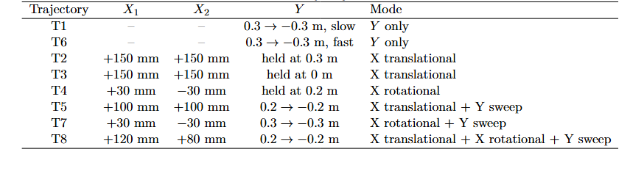
Trajectories
T1-T6 isolate simple motion types
Added T7 and T8 to improve coupling terms identifiability

Slide 32
Multisine design
Injected as force after controller
Schroeder-phase periodic multisine
  Resolution and padding
  Frequency bins
  Crest factor → Schroeder phase rule
Odd Harmonic Selection
Normalize multisine
Scale to candidate force level
Start ramp??
Notes:
s(t) = sum_i cos(2*pi*f_i*t + phi_i)
phi_i = -i(i-1)pi/F

Slide 33
Multisine Signal Construction
Goal:
- Broadband excitation for parameter recovery in one simulation.
Periodic Schroeder-phase multisine:
s(t) = sum_i cos(2*pi*f_i*t + phi_i)
Schroeder phases:
phi_i = -i(i-1)pi/F
Design choices:
- 1 s period → 1 Hz frequency resolution
- integer-period padding → leakage-free signal
- selected frequency bins within candidate band
- odd harmonics only → even lines left unexcited
- Schroeder phases → lower crest factor

Slide 34
Mode-Dependent Phase Offset
Modes
And: That is why the script adds the mode-dependent phase/time shift. So the concept is:
is equivalent to a time shift by \(\tau\). In your script:
common: [s_common, s_common, 0]
diff: [s_diff, -s_diff, 0]
y: [0, 0, s_y]

Slide 35
Why force injection after the controller?
- Reference trajectory remains clean.
- Extra excitation enters plant input directly.
- But closed-loop controller may reject it, so diagnostic scan is needed.
Modal force mapping
- common: [F, F, 0] -> X translation
- diff: [F,-F, 0] -> X rotation/yaw
- y: [0, 0, F] -> Y motion
Mode-dependent phase/time shift
- each mode gets a different phase offset
- reduces correlation when multiple modes are combined, e.g. T7/T8
Diagnostic candidate grid
- full scan: 5-20, 20-50, 50-100, 100-200, 200-400 Hz
- full scan force RMS: 10-800 N
- narrowed T7/T8 rerun used fewer candidates for speed
Safety and ranking
- accept only if force peak/RMS and motion/velocity limits are respected
- rank by force survival, extra output motion, and number of excited lines
Cumulative testing for multi-mode trajectories
- choose first mode
- keep it active while testing second mode
- keep both active while testing third mode

Slide 36
Diagnostics
Closed-loop controller can reject/counteract the injected multisine (feedback bandwidth 100 Hz)
First run without injecting the multisine store input and output.
  Want to know how much of the additional force survived and how much “extra” motion the multisine adds
Notes:
3 diagonal SISO feedback controllers
one for X1
one for X2
one for Y
ruleOfThumb(100, plant_axis, ts)
[F_X1, F_X2, F_Y]

Slide 37
Diagnostic force-multisine selection
Why?
- Multisine is injected as an additional plant force in closed loop.
- The 100 Hz feedback controller can partially reject this excitation.
- Therefore, injected force amplitude alone does not tell us whether the plant is actually excited.

Slide 38
Diagnostic force-multisine selection
Procedure
1. Simulate clean closed-loop trajectory:
f_ms = 0
store q_base and u_base
2. For each requested excitation mode:
common : [F, F, 0] -> X translation
diff : [F,-F, 0] -> rotation
y : [0, 0, F] -> Y motion
3. Test candidate bands/amplitudes
Frequency and force RMS combinations
Notes:
- frequency bands: 5-20, 20-50, 50-100, 100-200, 200-400 Hz
- RMS force levels: 10, 25, 50, 100, 200, 400, 800 N

Slide 39
Diagnostic force-multisine selection
4. Compare against the baseline / committed case:
extra motion:
Δq = q_trial - q_committed
surviving force:
Δu = (u_fb,trial - u_fb,committed) + f_trial
5. Rank candidate:
score = survival × RMS(extra motion) × sqrt(number of frequency lines)
6. Commit best safe candidate and repeat cumulatively for next mode.

Slide 40
Diagnostic force-multisine selection
Candidate accepted only if:
- actuator peak and RMS force limits are respected
- X, Y, and |X1 - X2| position limits are respected
- velocity limits are respected
Notes:
The reason is written in the code comment: acceleration from q1 would require double-differencing the Simulink output at 20 kHz, and that amplifies numerical/interpolation artifacts. So it can create false acceleration spikes that are not physically meaningful.

Slide 42
Trajectory analysis
FFT / frequency content
Step response / pole analysis

Slide 43
Problem
Shorter segments and multisine trajectories are worse then previous longer segments without multisine
I could run longer segments with multisine to identify the problem

Slide 44
Diagnostic force-multisine selection
Why?
- Multisine is injected as an additional plant force in closed loop.
- The 100 Hz feedback controller can partially reject this excitation.
- Therefore, injected force amplitude alone does not tell us whether the plant is actually excited.
Procedure
1. Simulate clean closed-loop trajectory:
f_ms = 0
store q_base and u_base
2. For each requested excitation mode:
common : [F, F, 0] -> X translation
diff : [F,-F, 0] -> rotation
y : [0, 0, F] -> Y motion
3. Test candidate bands/amplitudes:
50-100 Hz, 100-200 Hz
200 N RMS, 400 N RMS
4. Compare against the baseline / committed case:
extra motion:
Δq = q_trial - q_committed
surviving force:
Δu = (u_fb,trial - u_fb,committed) + f_trial
5. Rank candidate:
score = survival × RMS(extra motion) × sqrt(number of frequency lines)
6. Commit best safe candidate and repeat cumulatively for next mode.

Slide 45
Filter Hardware limit

Slide 46
Multi sine – reference
Why not anymore. Was not able to let any of the multisine forces survive and much worse results then without multisine
First tried multisine after controller but kept getting rejected

Slide 47
Multisine after controller injection

